Slide 1

uantum
Society
at Auburn

Slide 2

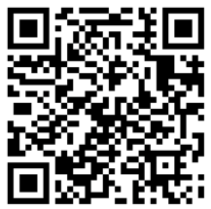
Join the GroupMe!
Fill out the interest form!

Slide 3


Quantum Circuits
Quantum Circuits are at the heart of Quantum Computing just as Classical Circuits are at the heart of Classical Computing.
Circuits are comprised of Quantum Gates acting on Qubits. The quantum gates manipulate the information held by the qubit to perform computations.
After this Measurement Operators are applied to read the information from the qubit.
Qubits
Gates
Measurements
Basic elements
of Quantum
Computing
Operators that
manipulate
Qubits
Operators that
Read information
From Qubits
$$|01⟩$$
$$|01⟩$$

Slide 4

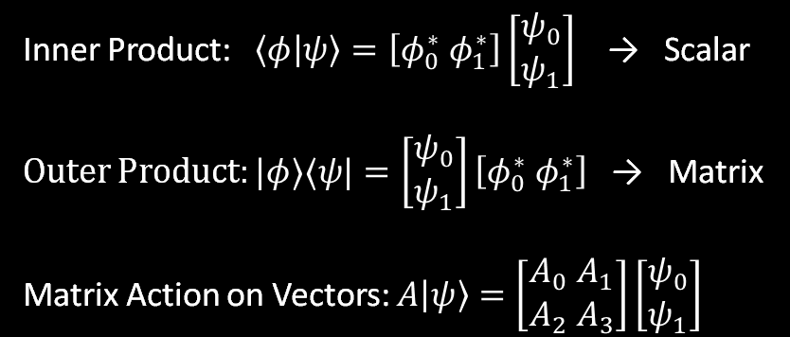
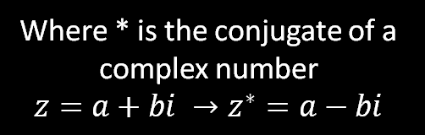

Math review + Dirac Notation
A Ket Vector is of the form: |ψ⟩
Physically a Ket Vector denotes a quantum state, but mathematically it denotes a vector in a Vector Space.
A Bra Vector is of the form: ⟨ψ|
Mathematically Bra vectors are used as maps that send Ket vectors to a Complex number.
Each Bra vector corresponds to a Ket Vector
Inner and Outer Products:
Bra vectors and Ket vectors can be combined to form the Inner Product and the Outer Product of the two states.
Acting on Ket Vectors:
Operators act on Ket Vectors by matrix multiplication.
Inner Product: $\left\langle φ | ψ\right\rangle =\left[φ_{0}^{∗} φ_{1}^{∗}\right]\left[\begin{aligned}ψ_{0} \\ ψ_{1}\end{aligned}\right]$ → Scalar
Outer Product: $|φ⟩⟨ψ|=\left[\begin{aligned}ψ_{0} \\ ψ_{1}\end{aligned}\right]\left[φ_{0}^{∗} φ_{1}^{∗}\right]$ → Matrix
Matrix Action on Vectors: $A\left|ψ\right\rangle =\left[\begin{aligned}A_{0} A_{1} \\ A_{2} A_{3}\end{aligned}\right]\left[\begin{aligned}ψ_{0} \\ ψ_{1}\end{aligned}\right]$
$$\left|φ\right\rangle =\left[\begin{aligned}φ_{0} \\ φ_{1}\end{aligned}\right]$$
$$\left\langle φ\right|=[φ_{0}^{∗} φ_{1}^{∗}]$$
Where * is the conjugate of a complex number
$$z=a+bi →z^{∗}=a−bi$$
$$|02⟩$$

Slide 5

Qubits
Hilbert Space
The space that all quantum
States exist in. They come
equipped with the Bra vectors,
Ket vectors, and the inner product
Qubits are the quantum analog to classical bits. Rather than existing in only one state 0 or 1, qubits can exist in a combination of the states 0 and 1.
Qubits Exist in Hilbert Spaces or State Spaces, which are spaces that are spanned by multiple different Basis States. These basis states are ket vectors that can be combined linearly to form any vector within the space.
Basis States
Known states that can be
combined to form any qubit in
the Hilbert Space. Typically
|0⟩ and |1⟩
Qubit
Quantum bits that exist as a linear
Combination of state spaces.
|ψ⟩ = a|0⟩ +b|1⟩ such that
|a|² + |b|² = 1
$$|01⟩$$
$$|03⟩$$

Slide 6

Quantum Gates
Quantum Gates
Matrices that act on Ket Vectors.
There are many ways to act on ket
Vectors including rotation,
reflection or phase shift
Quantum gates are the building blocks of quantum computation. Quantum Gates are Unitary Matrices that act on quantum states by matrix multiplication.
Unitary Matrices are elements of the Unitary Group, a set of invertible matrices that preserve the magnitude of quantum states.
Universal Gate Sets are a collection of Unitary Matrices that can be combined to approximate any element in the Unitary Group.
Unitary Matrices
Unitary Matrices preserve the
Magnitude of a quantum state.
|A|ψ⟩| = |ψ|
Unitary Group
There are many unitary matrices
that interest us, we use a small
Universal gate set to approximate
them all.
$$|01⟩$$
$$|04⟩$$

Slide 7

Measuring Quantum States
Consider the State:
|ψ⟩ = a|00⟩ +b|11⟩
Quantum states are measured via the inner product. Recall that the inner product of two states is a real number. This number correlates to the probability that the Ket vector is in the same state as the Bra vector.
For a single qubit |ψ⟩ = a|0⟩ +b|1⟩, the probability that |ψ⟩ is in state |0⟩ is |a|².
Multiple qubits can be measured simultaneously via the Tensor Product. The tensor product of the qubits combines them into one larger state.
State |0⟩ and state |1⟩ can be combined via the tensor product into |0⟩⊗|1⟩ or more simply |01⟩.
|ψ⟩ can collapse to 4 possible states:
|00⟩, |01⟩, |10⟩, |11⟩
The probability that |ψ⟩
is in state |00⟩ is:
⟨00|ψ⟩ = |a|²
The probability that |ψ⟩
is in state |01⟩ is:
⟨01|ψ⟩ = 0
The probability that |ψ⟩
is in state |10⟩ is:
⟨10|ψ⟩ = 0
The probability that |ψ⟩
is in state |11⟩ is:
⟨11|ψ⟩ = |b|²
$$|01⟩$$
$$|05⟩$$

